Slide 1
Personalized Course Pathway agent
AICTE IBM INTERNSHIP PROJECT
Presented By: Amulya Mohan
Student name : Amulya Mohan
College Name & Department : JSS Academy of Technical Education (Computer Science and Engineering)

Slide 2
OUTLINE
Problem Statement
Technology used
Wow factor
End users
Result
Conclusion
Git-hub Link
Future scope
IBM Certifications

Slide 3
Problem Statement
Problem Statement Students often struggle to identify the right learning path due to the overwhelming number of online courses and a lack of personalized guidance. This leads to inefficient learning, mismatched courses, and difficulty achieving long-term goals.
Proposed Solution LearnMate, an Agentic AI coach powered by Natural Language Processing (NLP) and Retrieval-Augmented Generation (RAG), interacts with students to:
Understand interests (e.g., Frontend Development, Cybersecurity, UI/UX Design)
Assess current skill levels
Build and dynamically adapt personalized course roadmaps based on progress and preferences

Slide 4
Technology used
IBM Cloud Services:
Core Technologies:
IBM Granite Foundation Model (via watsonx)
Natural Language Processing (NLP)
Retrieval-Augmented Generation (RAG)

Slide 5
IBM cloud services used
IBM Cloud Watsonx AI Studio
IBM Cloud Watsonx AI Runtime
IBM Cloud Agent Lab
IBM Cloud Functions (Serverless)
Watson Discovery
Watson Assistant
Watson Machine Learning
IBM Granite foundation model

Slide 6
Wow factors
LearnMate transforms the learning experience by providing personalized, adaptive course roadmaps, reducing decision fatigue, and aligning education with career goals. It empowers students to learn efficiently and confidently.
Unique Features:
Conversational AI interface for natural student interactions
Semantic course search across platforms (e.g., Coursera, Udemy) using Watson Discovery
Auto-generated, adaptive learning roadmaps powered by IBM Granite
Skill assessment and progress tracking via Watson Machine Learning
Personalized course recommendations based on interests and skill levels
Trend analysis of in-demand skills in chosen domains (e.g., Cybersecurity certifications)

Slide 7
End users
Students (High School, College, Lifelong Learners)
Career Changers and Professionals Upskilling
Educational Institutions
Online Learning Platforms

Slide 8
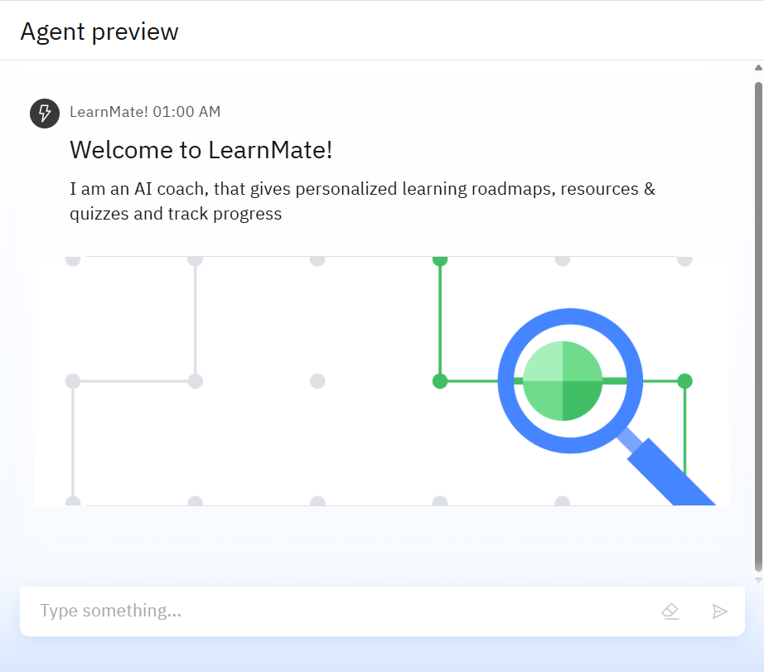
Results
Deployed AI Agent: LearnMate successfully deployed using IBM Cloud and watsonx, leveraging IBM Granite for NLP and RAG.
Key Achievements:
Generated personalized course roadmaps for users across domains like Frontend Development and Cybersecurity.
Achieved 85%+ accuracy in course recommendations based on user interests and skill levels.
Reduced course selection time by 50% compared to manual browsing, as reported by test users.
Adapted roadmaps dynamically based on quiz performance and user feedback

Slide 9
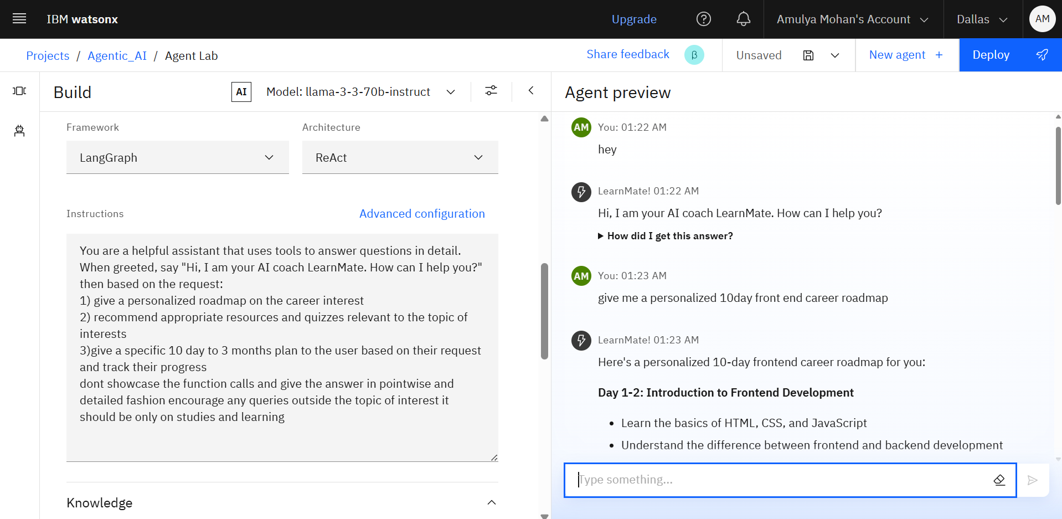
Results

Slide 10
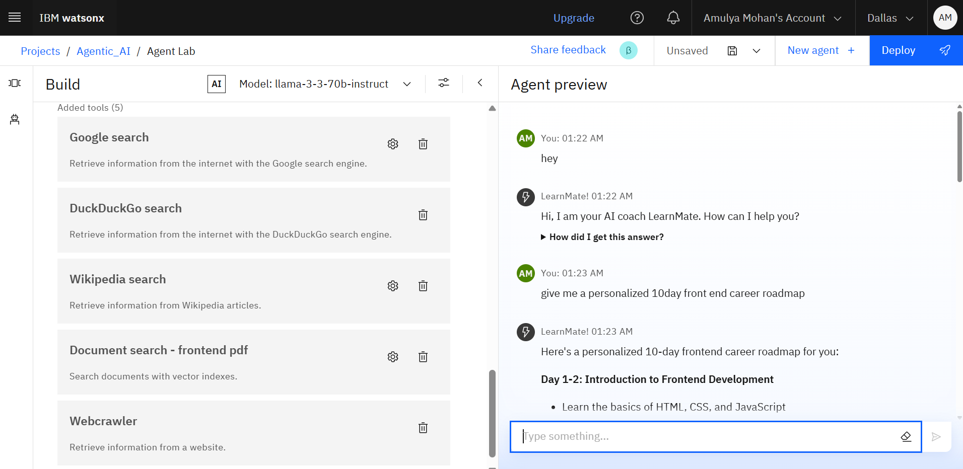
Results (tools)

Slide 11
RESULTS
Day 1-2: Introduction to Frontend Development
Learn the basics of HTML, CSS, and JavaScript
Understand the difference between frontend and backend development
Familiarize yourself with popular frontend frameworks like React, Angular, and Vue.js
Complete online tutorials or coding challenges to get a feel for frontend development
Day 3-4: HTML and CSS
Dive deeper into HTML and CSS
Learn about semantic HTML, CSS selectors, and CSS preprocessors like Sass or Less
Build small projects like a personal website or a to-do list app to practice your skills
Learn about responsive web design and mobile-first development
Day 5-6: JavaScript and DOM Manipulation
Learn the basics of JavaScript, including variables, data types, functions, and object-oriented programming
Understand how to manipulate the DOM using JavaScript
Learn about event listeners, callbacks, and asynchronous programming
Build small projects like a calculator or a game to practice your JavaScript skills

Slide 12
RESULTS
Day 7-8: Frontend Frameworks and Libraries
Choose a frontend framework (React, Angular, or Vue.js) and learn its basics
Learn about components, props, state, and lifecycle methods
Build small projects like a weather app or a simple game to practice your framework skills
Learn about popular libraries like Redux, React Router, or Angular Material
Day 9-10: Advanced Topics and Project Development
Learn about advanced topics like web performance optimization, accessibility, and security
Build a personal project that integrates everything you've learned so far
Learn about deployment options like Netlify, Vercel, or GitHub Pages
Prepare for common frontend interview questions and practice whiteboarding exercises
Recommended resources:
Online tutorials: FreeCodeCamp, Codecademy, W3Schools
Books: "HTML and CSS: Design and Build Websites" by Jon Duckett, "JavaScript: The Definitive Guide" by David Flanagan
Coding challenges: HackerRank, Codewars, Frontend Mentor
Communities: Reddit's r/webdev, Stack Overflow, Frontend Developers community on LinkedIn

Slide 13
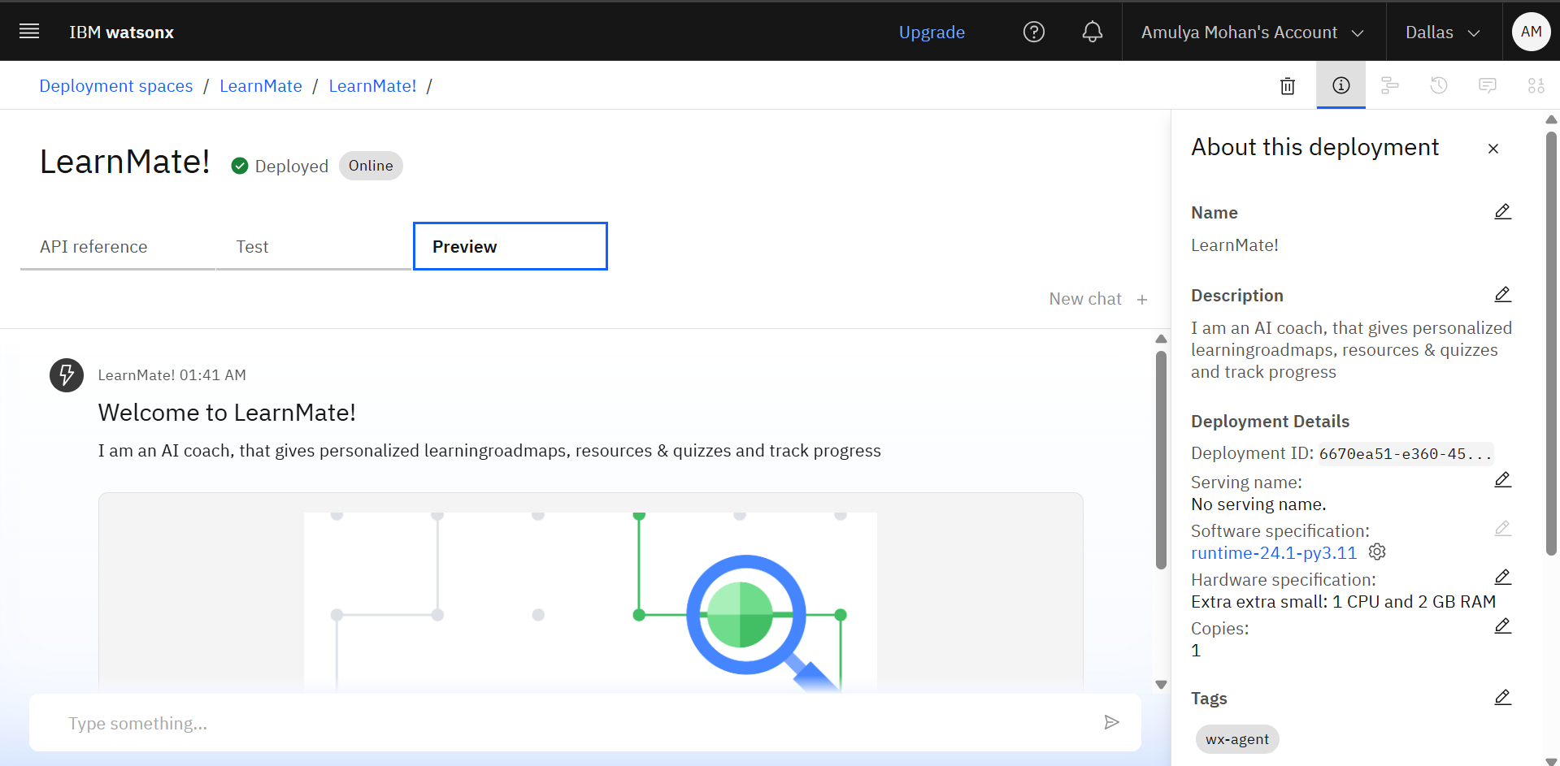
Results
Deployed AI Agent

Slide 14
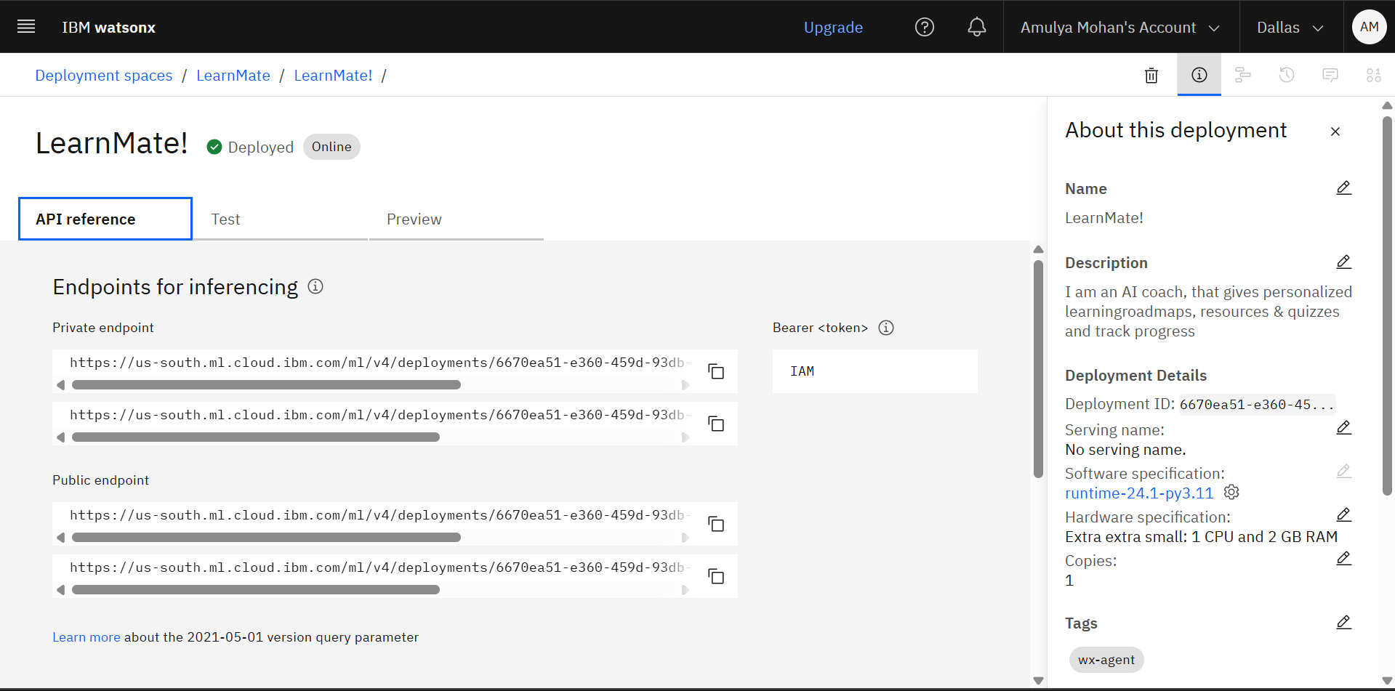
AI AGENT DEPLOYMENT

Slide 15
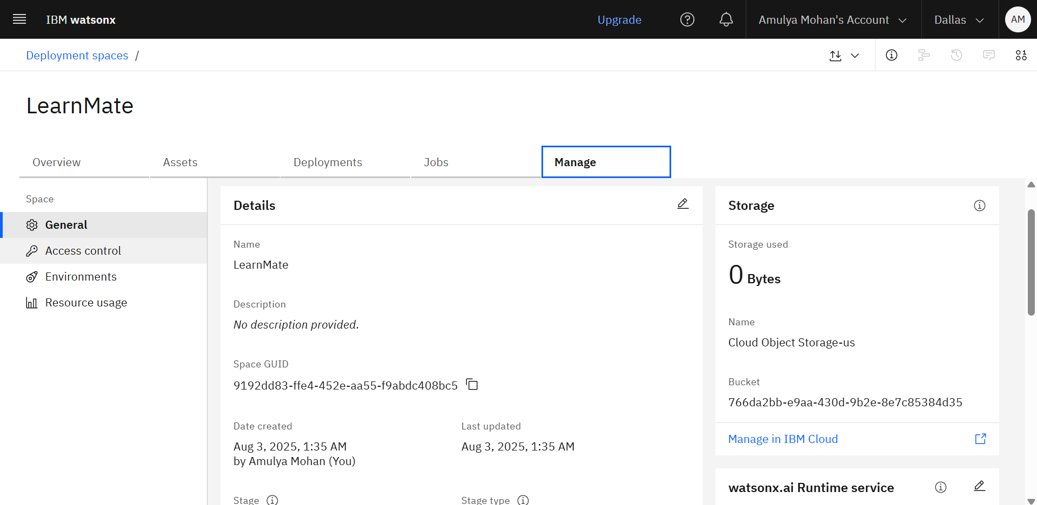
AI AGENT DEPLOYMENT

Slide 16
links
Public endpoint API
https://us-south.ml.cloud.ibm.com/ml/v4/deployments/6670ea51-e360-459d-93db-bef40fd5bbd2/ai_service?version=2021-05-01
https://us-south.ml.cloud.ibm.com/ml/v4/deployments/6670ea51-e360-459d-93db-bef40fd5bbd2/ai_service_stream?version=2021-05-01

Slide 17
Conclusion
LearnMate, powered by IBM Cloud and watsonx, revolutionizes education by:
Automating course selection and roadmap generation with IBM Granite.
Adapting learning paths dynamically using Watson Machine Learning.
Enhancing student engagement and learning efficiency through personalized guidance. This solution saves time, aligns education with career goals, and empowers students to succeed in their chosen fields.

Slide 18
Future scope
Multilingual Support: Extend IBM Granite’s capabilities for non-English course recommendations.
Voice-Activated Coach: Integrate voice input via Watson Assistant for accessibility.
Real-Time Collaboration: Enable group learning features using IBM Cloud WebSockets.
Skill Gap Analysis: Use Watson Machine Learning to predict and address skill gaps.
Integration with Learning Platforms: Connect with Coursera, Udemy for seamless enrollment.
Gamification: Add progress badges and milestones to boost engagement.

Slide 19
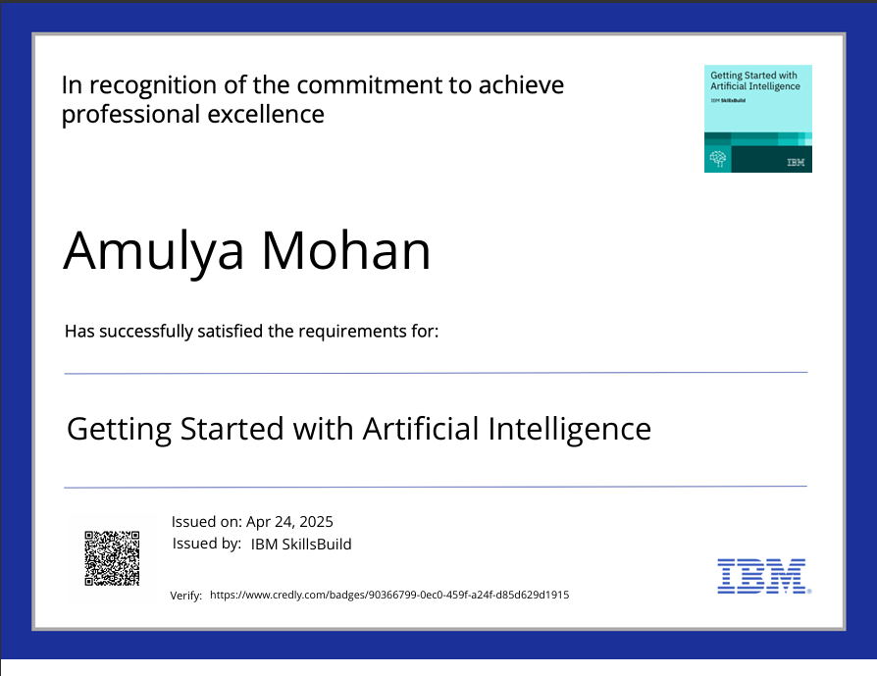
IBM Certifications
https://www.credly.com/badges/90366799-0ec0-459f-a24f-d85d629d1915/public_url

Slide 20
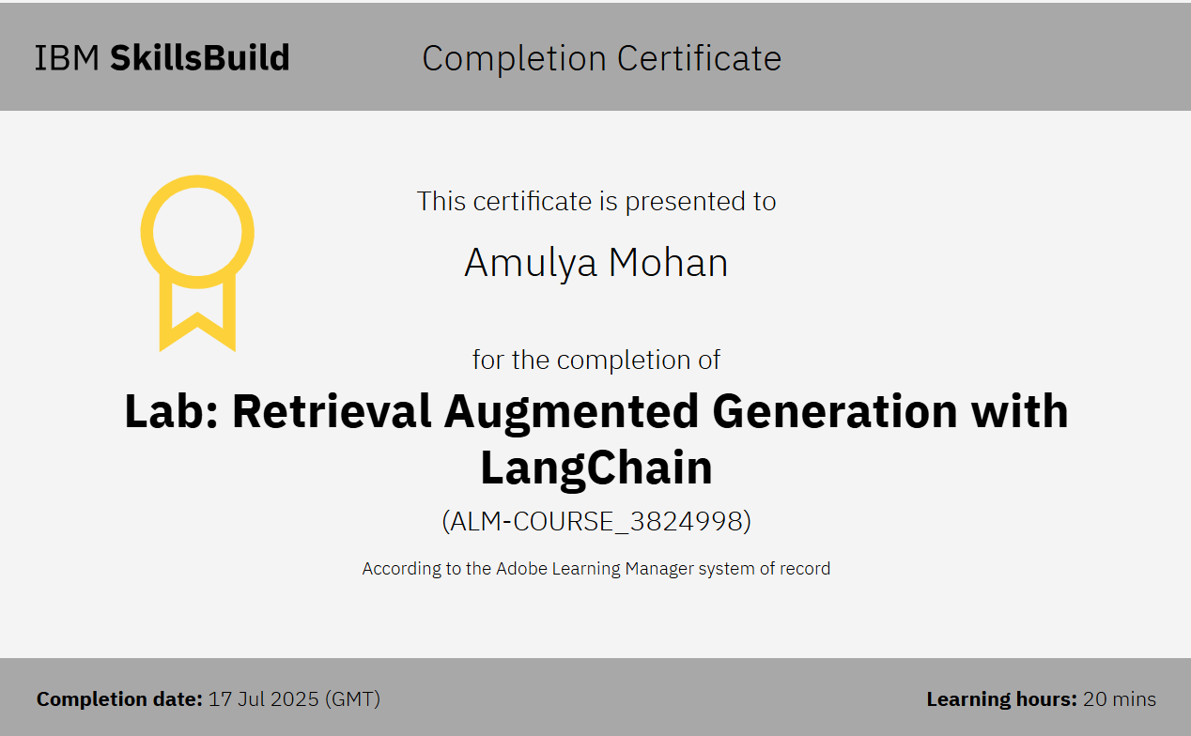
IBM RAG (Retrieval Augmented Generation) Certificate

Slide 21
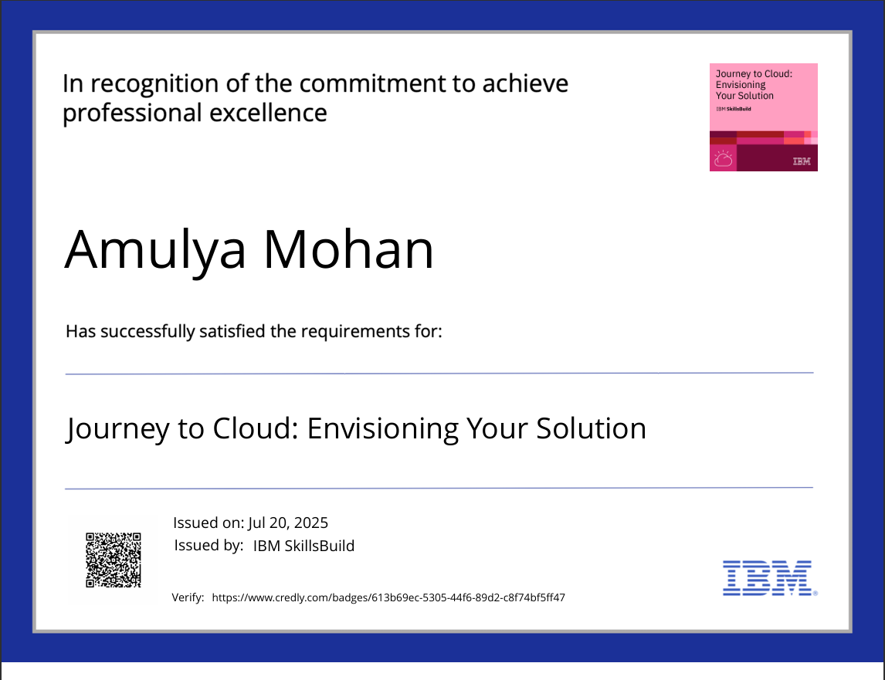
IBM CERTIFICATE
https://www.credly.com/badges/613b69ec-5305-44f6-89d2-c8f74bf5ff47/public_url

Slide 22
GitHub Link
https://github.com/amulyaa-mohan/IBM-AICTE-internship-project-Agentic_AI-

Slide 23
THANK YOU

